Slide 1

Power BI: Unveiling Crime Trends in India
This presentation showcases a comprehensive project using Power BI to visualize and analyze crime data in India.

Slide 2
Visualizing Crime Data in India with Power BI
Team
Project Goal
Sanika Raut – AIML
Shruti Kamble – Comps
Arpit Dubey - DE
To create interactive dashboards and reports that provide valuable insights into crime trends and patterns in India.

Slide 3

Introduction to the Project
1
Scope
2
Focus Areas
We analyzed a comprehensive dataset of crime data collected from various sources.
Our analysis focused on crime types, geographic distribution, and temporal trends.
3
Objectives
To identify patterns, understand underlying causes, and inform crime prevention strategies.

Slide 4
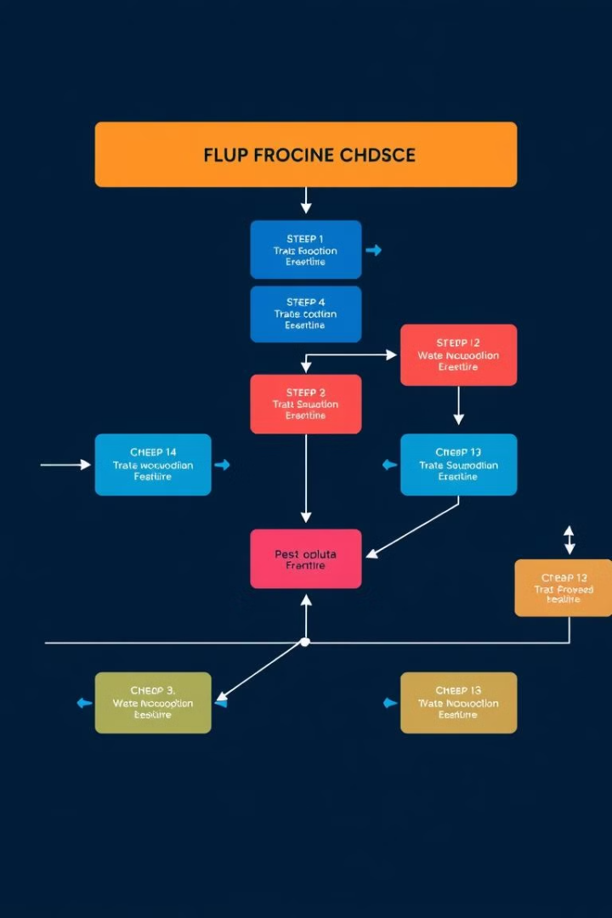
Data Sources and Preprocessing
Source 1
Source 2
National Crime Records Bureau (NCRB) – provides comprehensive crime statistics for India.
State Police Records – offer detailed data on crime incidents within specific regions.
Data Cleaning
We ensured data consistency, handled missing values, and standardized data formats.

Slide 5
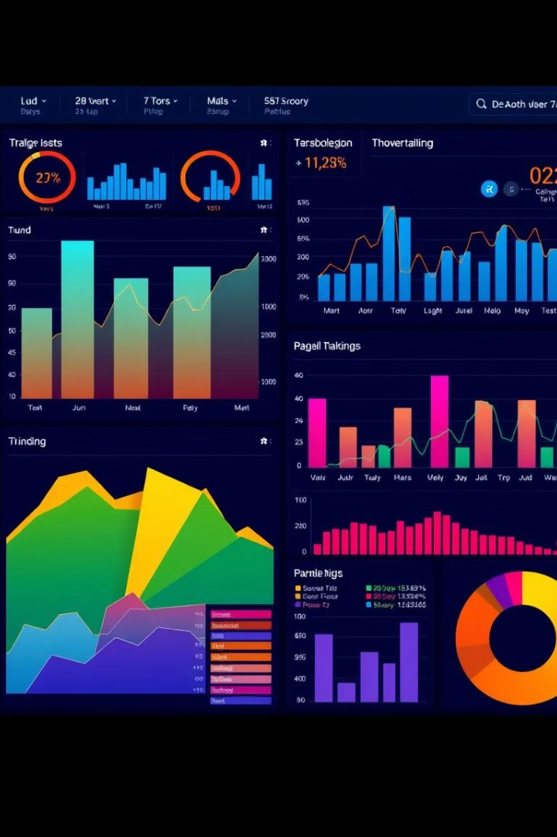



Designing Interactive Dashboards
Interactive Charts
Geographic Mapping
We incorporated bar charts, line graphs, and pie charts to display key crime statistics.
Maps visualize crime hotspots and trends across different cities and regions.
Filtering and Slicing
Users can filter data by crime type, location, and time period to explore specific insights.

Slide 6
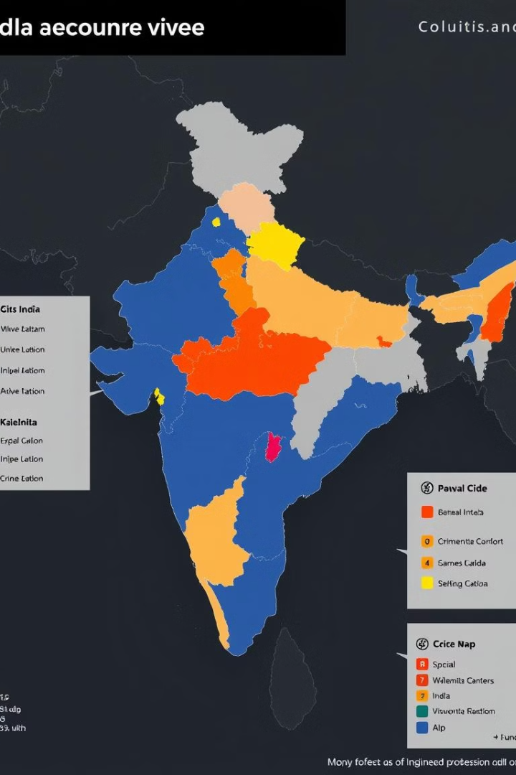
Mapping Crime Trends Across Cities
1
Trend Analysis
The dashboard showcases the spatial distribution of crime across major cities.
2
Hotspots
We identified high-crime areas by analyzing crime densities and incidence rates.
3
Comparative Analysis
The interactive map allows users to compare crime trends across different cities.

Slide 7
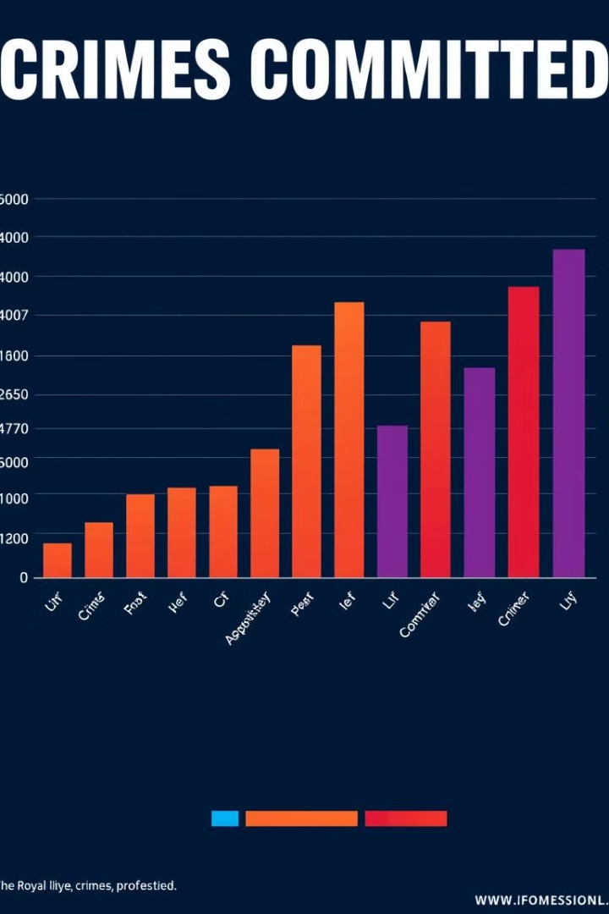



Analyzing Crime Rates by Type
Crime Categories
The dashboard provides a detailed breakdown of crime rates by category.
Trend Analysis
Visualizations highlight year-over-year changes in crime rates for each category.
Insights
We identified emerging crime trends and potential areas for prevention efforts.

Slide 8



Predictive Analytics and Insights
Predictive Models
1
We implemented machine learning models to predict future crime trends.
Risk Assessment
2
The model identifies areas at high risk of future crime based on historical data.
Recommendations
3
The insights from our analysis can be used to inform crime prevention strategies.

Slide 9

Conclusion and Next Steps
Our Power BI project has provided valuable insights into crime trends and patterns in India, enabling stakeholders to make data-driven decisions.

